Slide 1
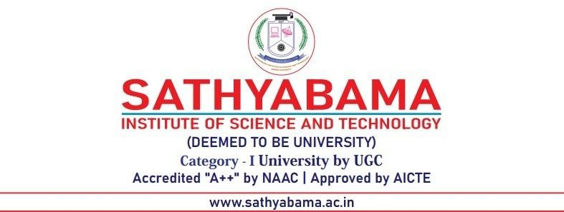
DEPARTMENT OF COMPUTER SCIENCE AND ENGINEERING
Professional Training - 1
COMPLAINT MANAGEMENT SYSTEM
PROJECT STUDENT Internal Guide:
Akshaya G (42110055) Mrs. M. Vanathi M.E.,(Ph.D).,

Slide 2
AGENDA
Certificate
Introduction
Abstract
Objective
System Architecture / Ideation Map
Module Implementation
Results and Discussions
Conclusion
References

Slide 3
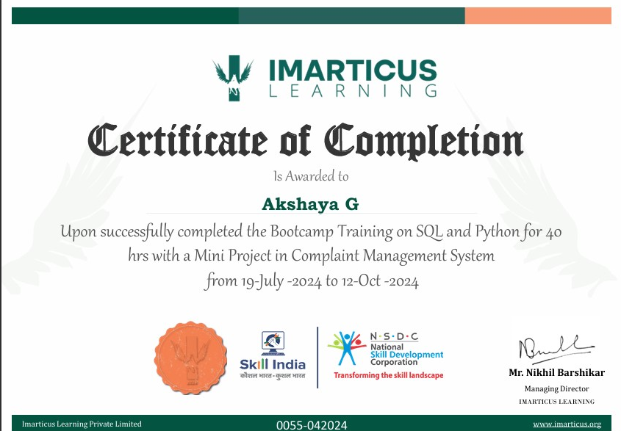
COURSE CERTIFICATE

Slide 4
INTRODUCTION
In today's dynamic educational landscape, maintaining open lines of communication between students and university administration is crucial for creating a positive academic experience.
The Complaint Management System (CMS) is designed to address the growing need for an efficient and transparent process for handling student complaints.
By leveraging modern technology, the CMS will provide an intuitive interface for users, enabling students to submit complaints with ease.
This system will not only facilitate a transparent communication channel but will also empower the university to identify recurring issues and implement proactive measures.

Slide 5
ABSTRACT
Complaint Management System (CMS) is a user-friendly application designed to streamline the process of submitting, tracking, and resolving complaints within a university environment.
It is built using Python and Tkinter for the graphical user interface, and MySQL for backend data management, the system facilitates efficient communication between students and administrative staff.
Users can register with email validation and password strength checks, ensuring secure access to the system. Once logged in, users can submit complaints with essential details, view existing complaints filtered by department, and withdraw complaints if necessary.
The application emphasizes usability and data integrity, employing crypt for secure password storage and implementing comprehensive input validation.

Slide 6
OBJECTIVE
The objective of this study is to develop a Complaint Management System (CMS) utilizing Python and MySQL to facilitate the efficient management of complaints submitted by users in a university setting. The specific objectives include:
User Registration and Authentication
Complaint Submission
Complaint Management
Withdrawal of Complaints
Data Security
User-Friendly Interface
Foundation for Future Enhancements

Slide 7
LITERATURE SURVEY
Author/Source | Key Contributions | Technology/ Frameworks | Year
Python Official Documentation | Provides comprehensive documentation and guidelines for Python programming. | Python | Ongoing
Tkinter Documentation | Guide for building graphical user interfaces (GUIs) in Python using Tkinter. | Python (Tkinter) | Ongoing

Slide 8
LITERATURE SURVEY
Author/Source | Key Contributions | Technology/ Frameworks | Year
"Learning SQL" by Alan Beaulieu | Explains SQL fundamentals, including queries, transactions, and database management techniques. | MySQL | 2009
"Python Crash Course" by Eric Matthes | Step-by-step guide to Python programming, with practical examples that build real-world applications. | Python | 2019
.

Slide 9
SYSTEM ARCHITECTURE / IDEATION MAP
The Complaint Management System (CMS) is designed using a layered architecture that separates concerns across three main layers:
Presentation Layer (User Interface)
Technology Used: Tkinter (Python GUI)
Application Layer (Business Logic)
Technology Used: Python
Data Layer (Database)
Technology Used: MySQL
This architecture promotes maintainability, scalability, and ease of use.

Slide 10
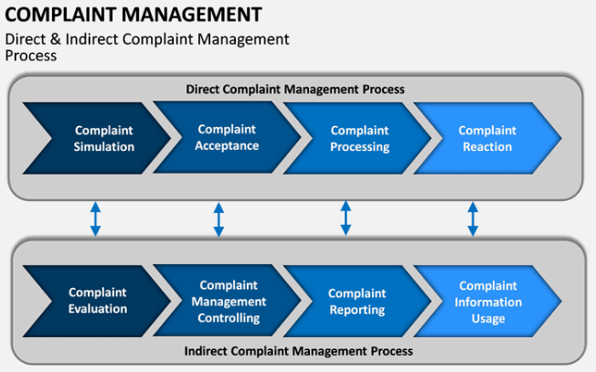

Slide 11
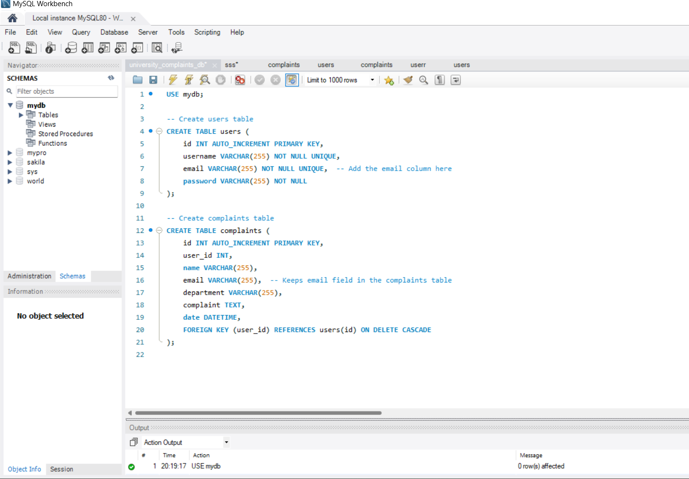
MODULE IMPLEMENTATION
SQL

Slide 12
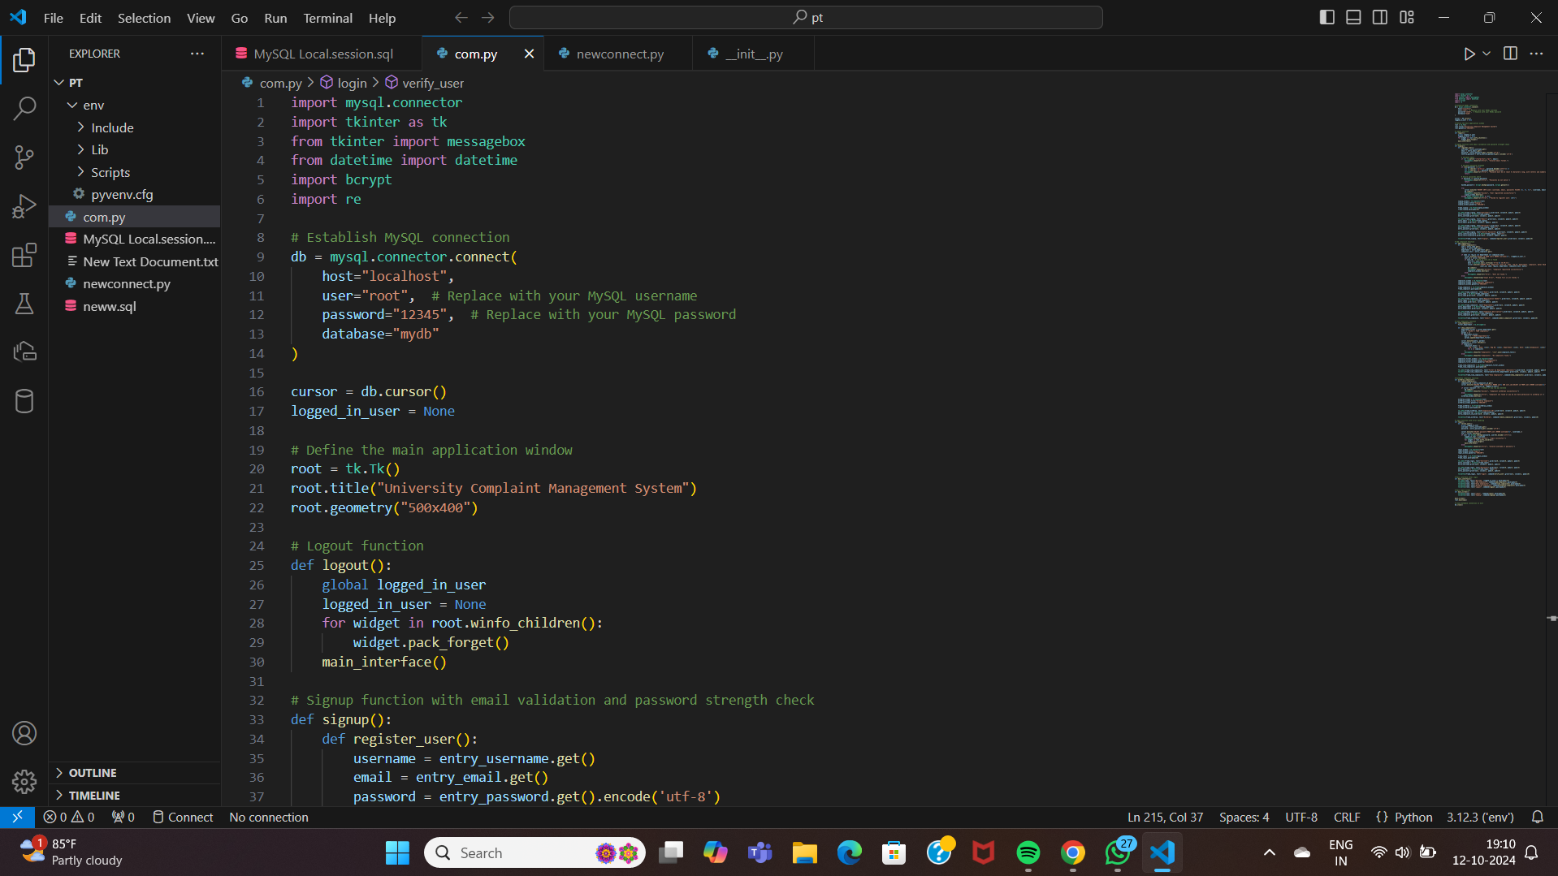
MODULE IMPLEMENTATION
Python

Slide 13
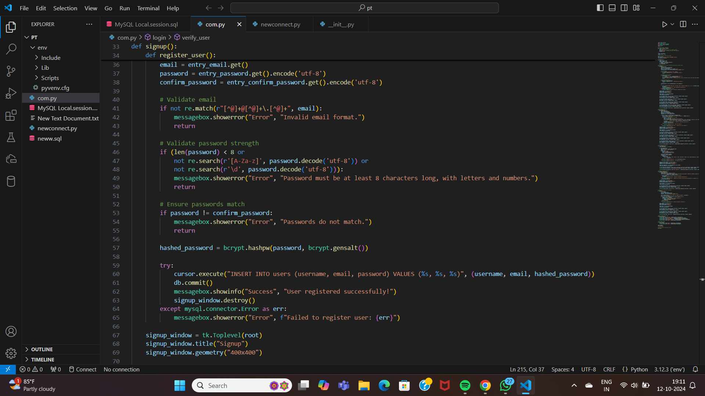
MODULE IMPLEMENTATION

Slide 14
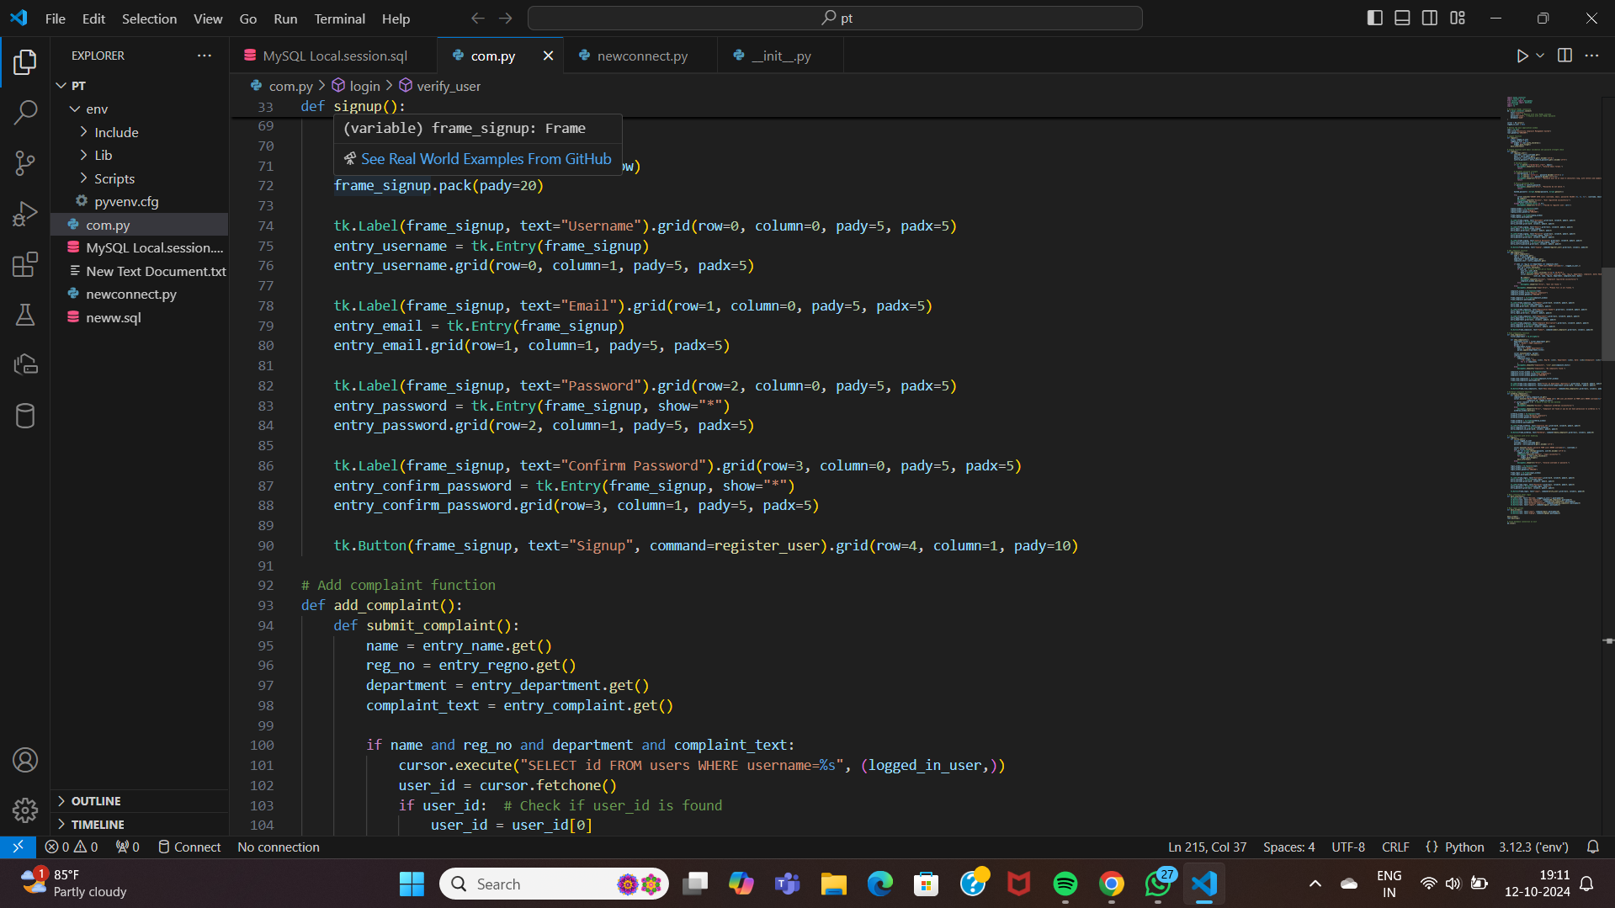
MODULE IMPLEMENTATION

Slide 15
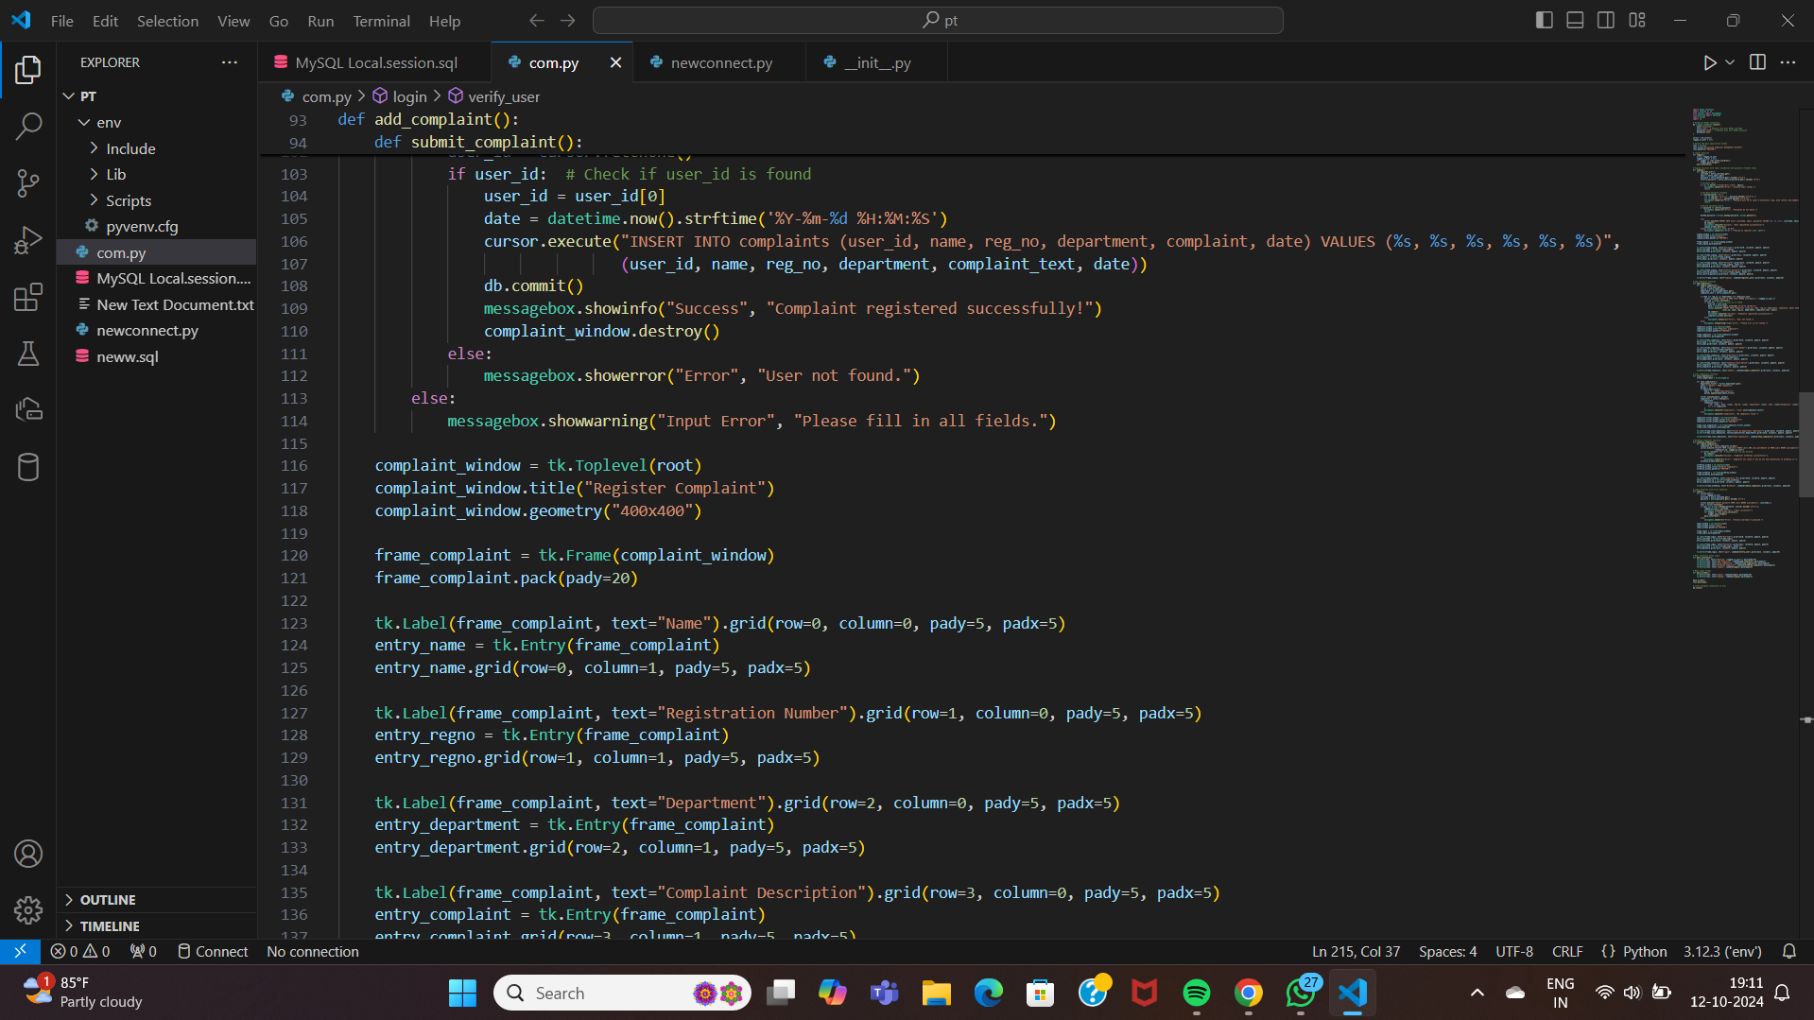
MODULE IMPLEMENTATION

Slide 16
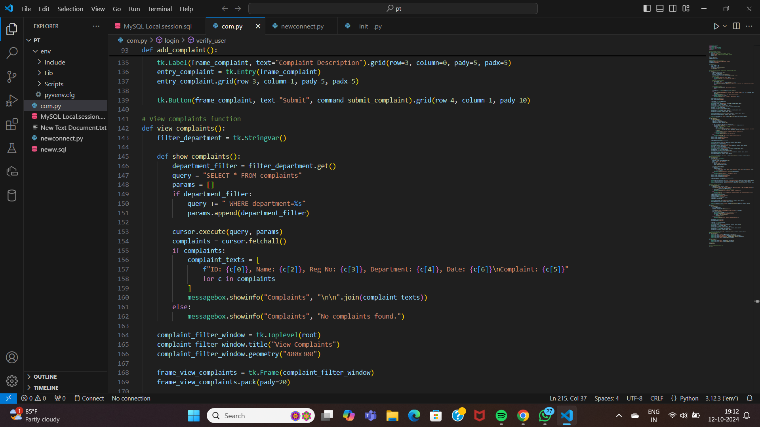
MODULE IMPLEMENTATION

Slide 17
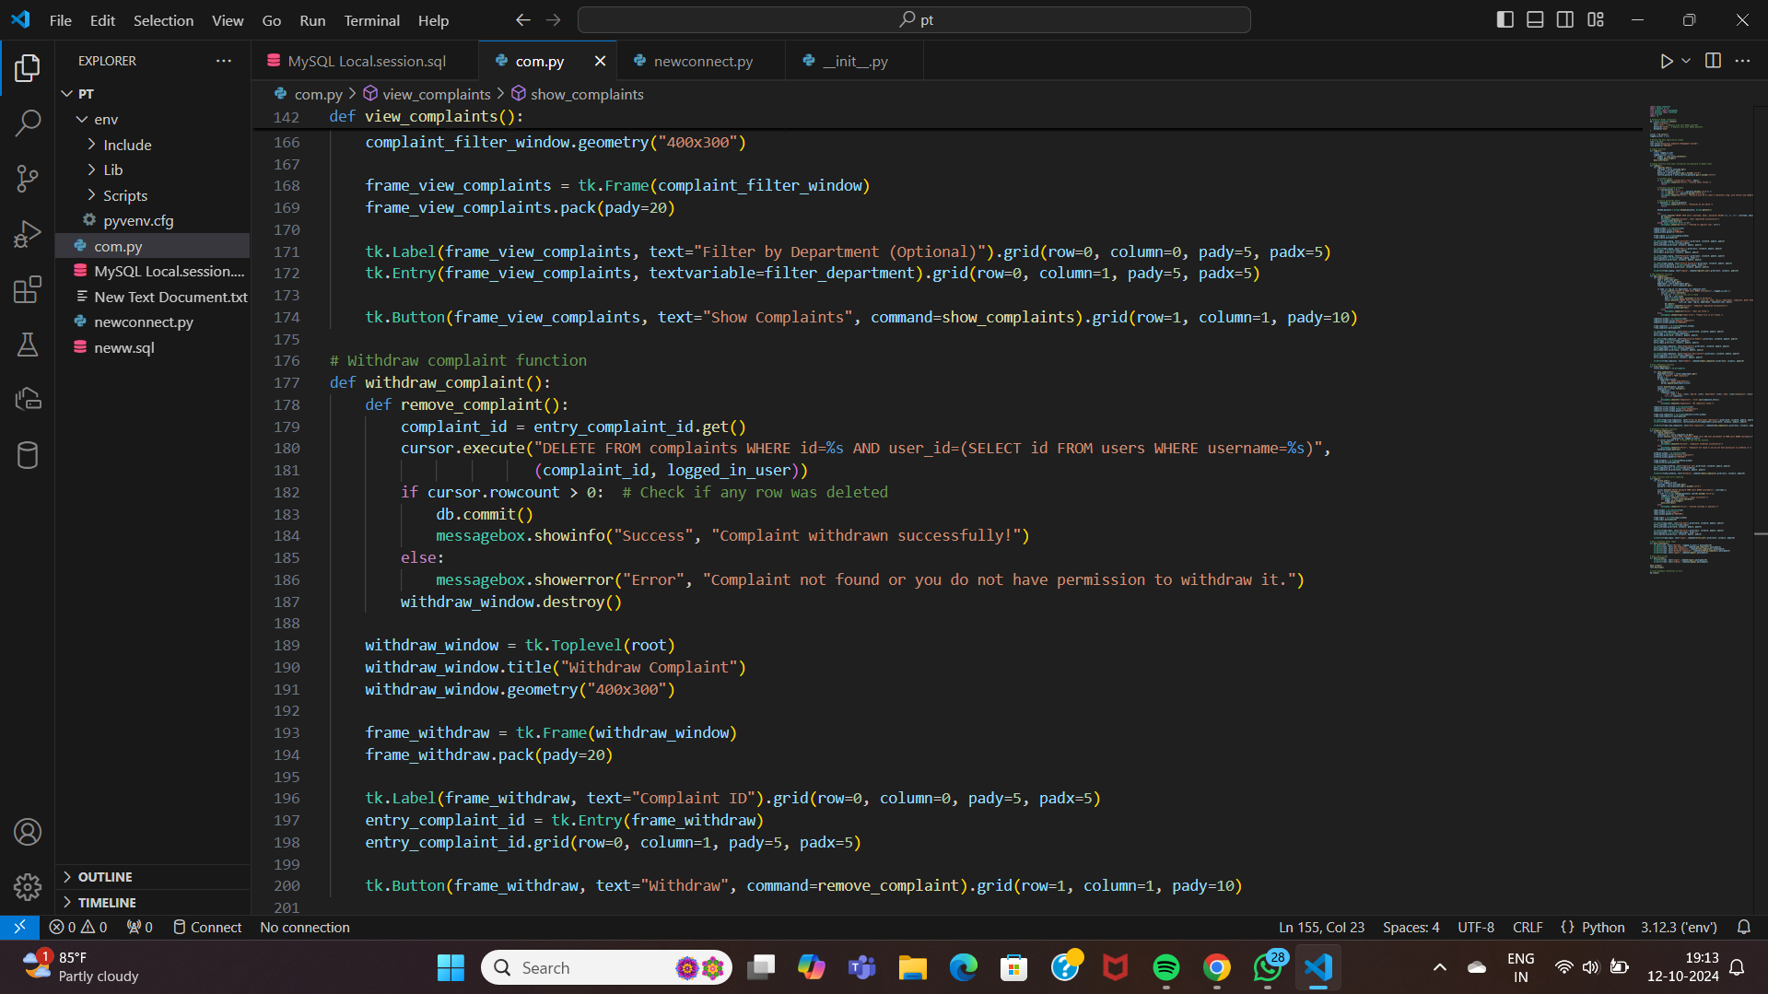
MODULE IMPLEMENTATION

Slide 18
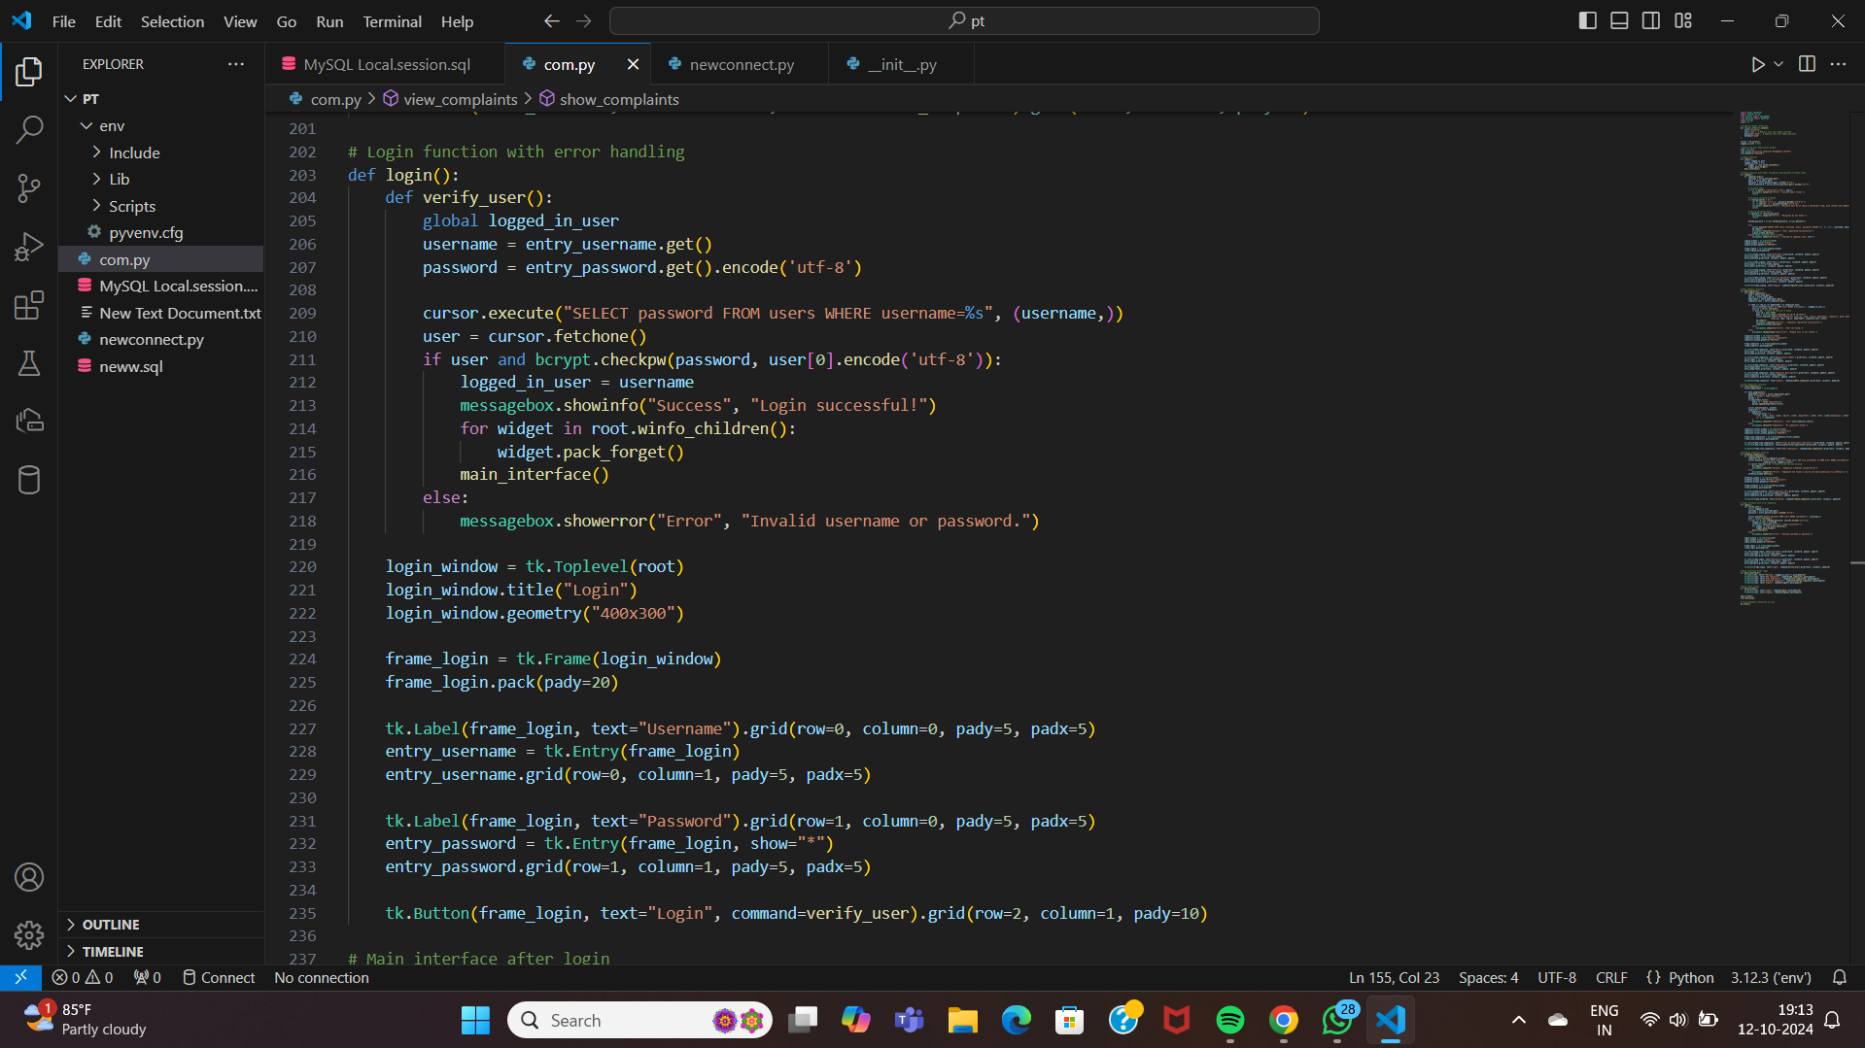
MODULE IMPLEMENTATION

Slide 19
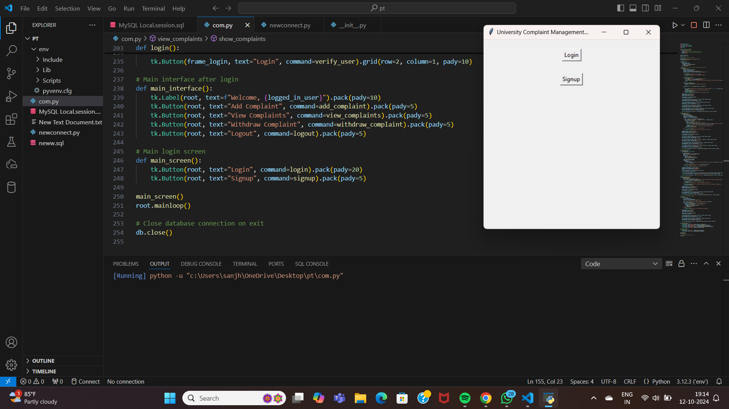
MODULE IMPLEMENTATION

Slide 20
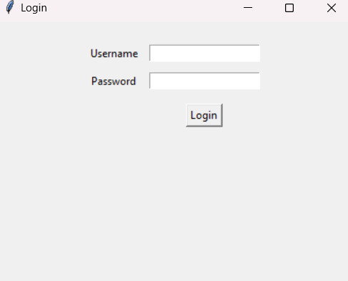
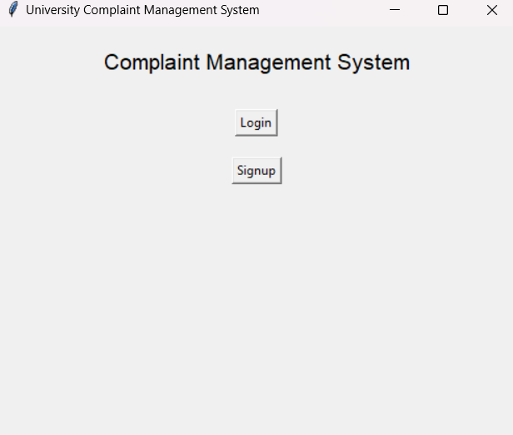
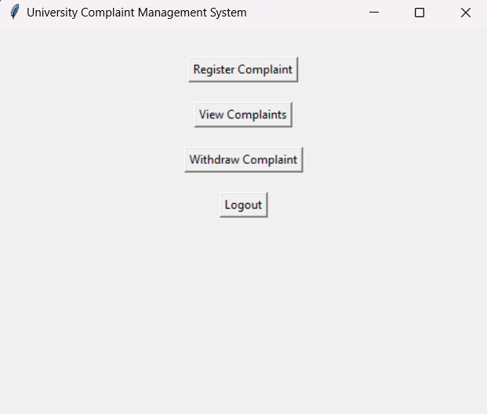
RESULTS AND DISCUSSIONS
CMS User Interface
login credentials implementation
login page

Slide 21
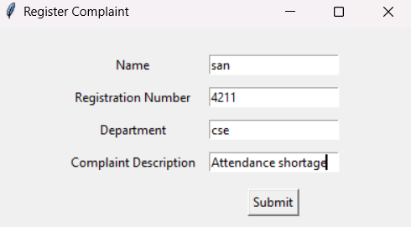
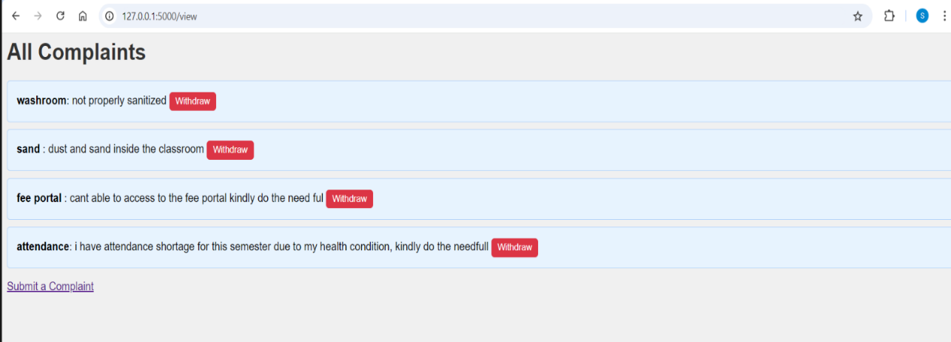
RESULTS AND DISCUSSIONS
Complaint Registration
All Complaints

Slide 22
CONCLUSION
In conclusion, the complaint management system developed using Python and SQL provides an efficient and user-friendly platform for handling customer grievances.
By leveraging Python's robust programming capabilities and SQL's powerful database management features, the system ensures seamless data storage, retrieval, and processing.
This project not only streamlines the complaint resolution process but also enhances customer satisfaction by providing timely feedback and support.
Future enhancements could include integrating machine learning for sentiment analysis and implementing a more intuitive user interface, further improving the system's effectiveness and usability.

Slide 23
REFERENCES
[1.]Zelle, J. M. (2010). Python Programming: An Introduction to Computer Science. Franklin, Beedle & Associates Inc.
[2.]Matthes, E. (2019). Python Crash Course: A Hands-On, Project-Based Introduction to Programming. No Starch Press.
[3.]Beaulieu, A. (2009). Learning SQL. O'Reilly Media.
[4.]Grinberg, M. (2018). Flask Web Development: Developing Web Applications with Python. O'Reilly Media.
[5.]Lutz, M. (2013). Learning Python. O'Reilly Media.
[6.]Silberschatz, A., Korth, H. F., & Sudarshan, S. (2019). Database System Concepts. McGraw-Hill Education.
[7.]Sweigart, A. (2015). Automate the Boring Stuff with Python. No Starch Press.
[8.]Stallings, W. (2017). Cryptography and Network Security: Principles and Practice. Pearson.
[9.]Brown, M. & Cross, D. (2015). SQL The Complete Reference. McGraw-Hill.
[10.]McKinney, W. (2017). Python for Data Analysis. O'Reilly Media.

Slide 24
THANK YOU
I would like to extend my sincere thanks to my mentors and peers who have supported and guided me throughout the course and project.

